Slide 1
Module: Shellcoding
Data Execution Prevention
Yan Shoshitaishvili
Arizona State University

Slide 2
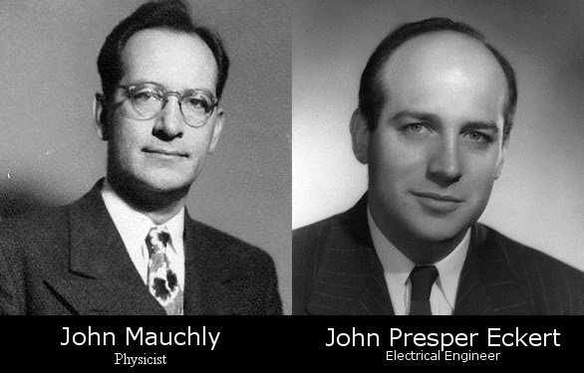
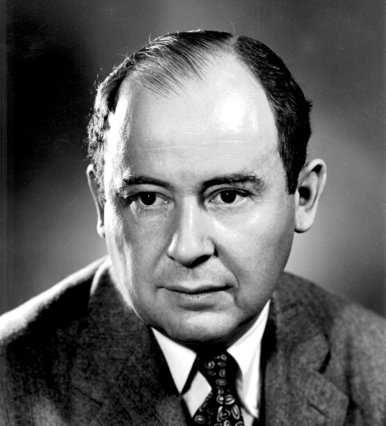
John Mauchly (Physicist), John Presper Eckert (Electrical Engineer), John Von Neumann (Mathematician)
John von Neumann, First Draft of a Report on the EDVAC, 1945.

Slide 3
CODE
DATA

Slide 4
CODE
DATA

Slide 5
Shellcode Mitigation: the "No-eXecute" bit
Finally, computer architectures wised up!
Modern architectures support memory permissions:
PROT_READ allows the process to read memory
PROT_WRITE allows the process to write memory
PROT_EXEC allows the process to execute memory
Intuition: normally, all code is located in .text segments of the loaded ELF files. There is no need to execute code located on the stack or in the heap.
By default in modern systems, the stack and the heap are not executable.
YOUR SHELLCODE NEEDS TO EXECUTE.
Game over?

Slide 6

A simpler shellcode...
The rise of NX has made shellcoding rarer.
It is now... an ancient art!

Slide 7
Remaining Injection Points - de-protecting memory
Memory can be made executable using the mprotect() system call:
Trick the program into mprotect(PROT_EXEC)ing our shellcode.
Jump to the shellcode.
How do we do #1?
Most common way is code reuse through Return Oriented Programming. We will cover this in a future module.
Other cases are situational, depending on what the program is designed to do.

Slide 8
Remaining Injection Points - JIT
Enter: Just in Time Compilation.
Just in Time compilers need to generate (and frequently re-generate) code that is executed.
Pages must be writable for code generation.
Pages must be executable for execution.
Pages must be writable for code re-generation.
The safe thing to do would be to:
mmap(PROT_READ|PROT_WRITE)
write the code
mprotect(PROT_READ|PROT_EXEC)
execute
mprotect(PROT_READ|PROT_WRITE)
update code
etc...

Slide 9
Remaining Injection Points - JIT
System calls are SLOW.
The point of JIT is to be FAST.
SLOW and SAFE tends to lose to FAST.
Writable AND executable pages are common.
If your binary uses a library that has a writable+executable page, that page lives in your memory space!

Slide 10
Remaining Injection Points - JIT
What if the JIT safely mprotect()s its pages?
Shellcode injection technique: JIT spraying.
Make constants in the code that will be JITed: var evil = "%90%90%90%90%90";
The JIT engine will mprotect(PROT_WRITE), compile the code into memory, then mprotect(PROT_EXEC). Your constant is now present in executable memory.
Use a vulnerability to redirect execution into the constant.

Slide 11
Remaining Injection Points - JIT
JIT is used everywhere: browsers, Java, and most interpreted language runtimes (luajit, pypy, etc), so this vector is very relevant.

Slide 12
Mitigation: Sandboxing
What if we accept that the attacker will get code execution, but try to limit the damage they can do?
Stay tuned!

